Slide 1
Machine Learning Applications
Smriti Singh and Phansa Chaonpoj

Slide 2
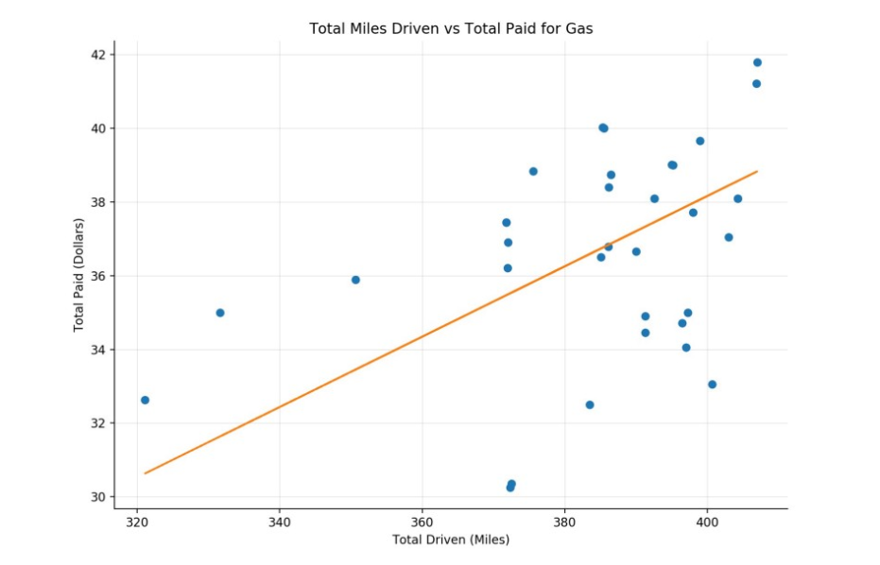
Linear Regression Algorithm
For linear data
Simple
Applications:
Predictions of future data
Financial forecasting
Software cost prediction
Restructuring budget
Crime data mining
Notes:
How it works: Linear regression is a linear model, e.g. a model that assumes a linear relationship between the input variables (x) and the single output variable (y). More specifically, that y can be calculated from a linear combination of the input variables (x).

Slide 3
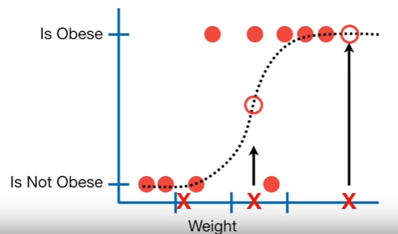
Logistic Regression
Applications
Image segmentation and categorization
Geographic image processing
Handwriting recognition
Healthcare
Notes:
How it works: Logistic Regression measures the relationship between the dependent variable (our label, what we want to predict) and the one or more independent variables (our features), by estimating probabilities using it’s underlying logistic function.
Healthcare : Analyzing a group of over million people for myocardial infarction within a period of 10 years is an application area of logistic regression.
Prediction whether a person is depressed or not based on bag of words from the corpus seems to be conveniently solvable using logistic regression and SVM.
Logistic Regression measures the relationship between the dependent variable (our label, what we want to predict) and the one or more independent variables (our features), by estimating probabilities using it’s underlying logistic function.
Logistic Regression is the go-to method for binary classification. It gives you a discrete binary outcome between 0 and 1. To say it in simpler words, it’s outcome is either one thing or another.

Slide 4
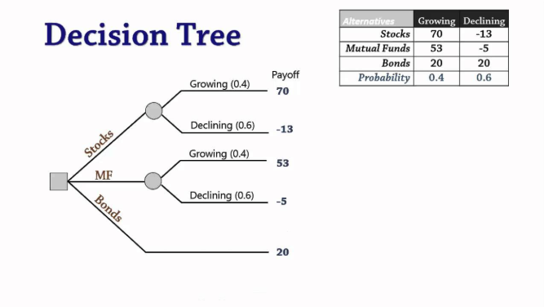
Decision Trees
Application
Data mining
Classifying
Predictions
Decision making
Notes:
How it works: Decision tree builds classification or regression models in the form of a tree structure. It breaks down a dataset into smaller and smaller subsets while at the same time an associated decision tree is incrementally developed. The final result is a tree with decision nodes and leaf nodes.
Classifying: spam email, tumor cancerous?
Predict which new free trial users would ultimately become paying customers
Applicant would receive a loan or that applicant would default

Slide 5
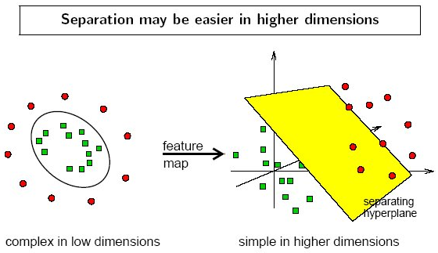
Support Vector Machines
Classification Problems
Projecting to different dimensionality (Kernal function)
Categorizing the extreme cases
Notes:
How it works: Support Vectors are simply the co-ordinates of individual observation. Support Vector Machine is a frontier which best segregates the two classes (hyper-plane/ line).

Slide 6
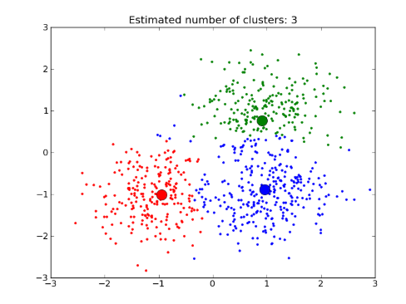
Clustering Algorithm
Categorizing data
Customer segmentation
Stat analysis
Insurance fraud detection
Rideshare data analysis
Cyber profiling criminals
Notes:
How it works: the algorithm calculates the average of all the points in a cluster and moves the centroid to that average location. After the point moves, it becomes the “clustering” of data on the chart to segment different data points.
https://dzone.com/articles/10-interesting-use-cases-for-the-k-means-algorithm

Slide 7
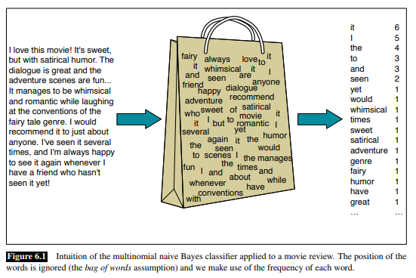
Naïve Bayes
Best for category variable analysis
Spam emails
Sentiment analysis (text)
Decision making (Prediction)
Notes:
How it works: Naive Bayes is a kind of classifier which uses the Bayes Theorem. It predicts membership probabilities for each class such as the probability that given record or data point belongs to a particular class.
https://www.quora.com/In-what-real-world-applications-is-Naive-Bayes-classifier-used
https://web.stanford.edu/~jurafsky/slp3/6.pdf

Slide 8
Deep Learning Algorithms

Slide 9
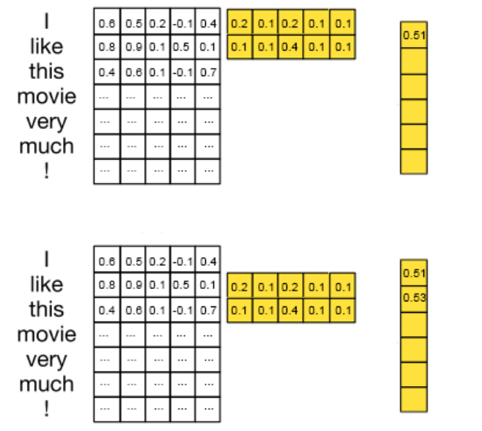
Convolution Neural Network (CNN)
Image analysis
Face recognition
Face detection
Data dimension reduction
Notes:
A CNN will learn to recognize patterns across space. So, as you say, a CNN will learn to recognize components of an image (e.g., lines, curves, etc.) and then learn to combine these components to recognize larger structures (e.g., faces, objects, etc.).
http://www.joshuakim.io/understanding-how-convolutional-neural-network-cnn-perform-text-classification-with-word-embeddings/
Filtering method, multiply matrices and average until it gives a number value

Slide 10
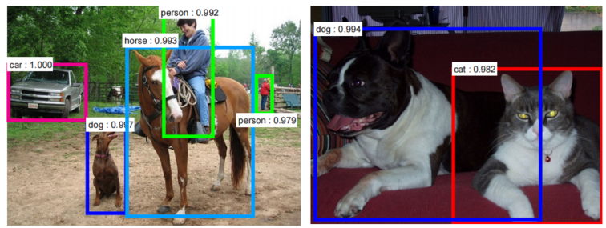
CNN Continued

Slide 11
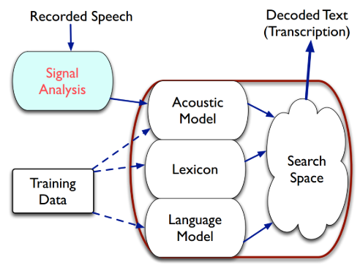
Recurrent Neural Network (RNN or LSTM)
Sentiment analysis (LSTM)
Speech recognition
Anomaly detection in time series
Grammar learning
Hand writing recognition
Human action recognition
Sign language translation
Prediction in medical care pathways
Notes:
RNN will similarly learn to recognize patterns across time. So a RNN that is trained to translate text might learn that "dog" should be translated differently if preceded by the word "hot".
https://en.wikipedia.org/wiki/Long_short-term_memory#Applications

Slide 12
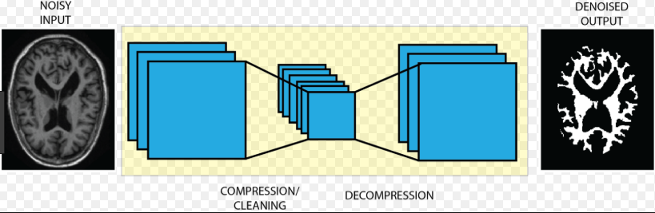
Autoencoder
Data denoising
Dimensionality reduction
Image reconstruction
Image colorization
Notes:
Autoencoders (AE) are a family of neural networks for which the input is the same as the output*. It tries to reconstruct its input to produce the same output.
https://blog.insightdatascience.com/brain-mri-image-segmentation-using-stacked-denoising-autoencoders-4e91417688f6
Brain MRI image segmentation using stacked denoising autoencoders
https://hackernoon.com/autoencoders-deep-learning-bits-1-11731e200694

